Slide 1
Assignment E1: Snapshots of brightness temperature from a hurricane.
Eduardo Jimenez Hernandez, BE PhD student
ATMO555 Introduction to Atmospheric and Hydrologic Remote Sensing
University of Arizona
8/31/2021

Slide 2
Description
Steps I followed to create snapshots of brightness temperature data from netCDF4 files.
Downloaded the data from GES DISC for hurricane Grace, the most active hurricane at the time.
Created a Windows PowerShell script to automatically download the data for the entire day (August 21, 2021).
Configure my Windows system to allow the execution of these scripts.
Used the Anaconda IDE distribution of the Python programming language to create a special environment in which I installed Python 3.6, GDAL, and matplotlib.
The GDAL library allows us to open the climate data, and matplotlib to create a figure for the snapshots.

Slide 3
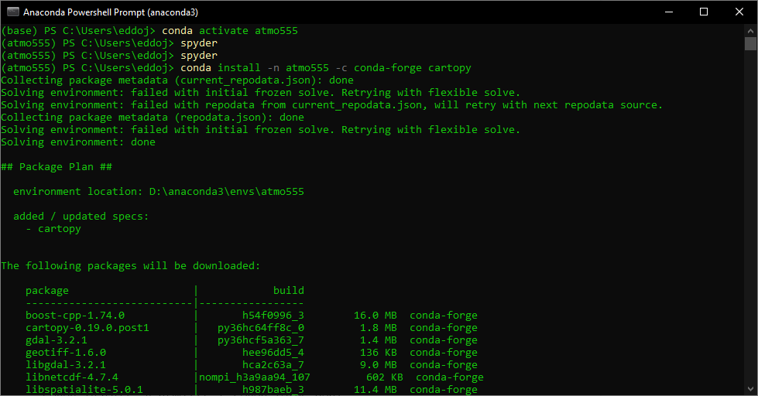
Conda environment
Install libraries, for this project we need gdal, matplotlib and cartopy. I also installed spyder to edit the Python code.
conda install -n atmo555 -c conda-forge gdal
conda install -n atmo555 -c conda-forge matplotlib
conda install -n atmo555 -c conda-forge spyder
conda install -n atmo555 -c conda-forge cartopy
conda create --name atmo555
conda install -n atmo555 python=3.6
conda activate atmo555

Slide 4
Code
# -*- coding: utf-8 -*-
""" ATMO555 Assignment 02. Brightness temperature from netCDF4 file, 8/30/2021
@author: eduardo
"""
from osgeo import gdal
import matplotlib.pyplot as plt
import cartopy.crs as ccrs
THRESHOLD = 180 # Remove data below this temp (in Kelvin)
# Open the netCDF4 file
dr = 'DATA/'
fn = 'merg_2021082103_4km-pixel.nc4'
ds = gdal.Open(dr + fn)
# Open the subdataset in the format 'NETCDF:"DATA/merg_2021082103_4km-pixel.nc4":Tb'
tb = gdal.Open(ds.GetSubDatasets()[0][0])
# Get the geotransform metadata (extension) of the figure to scale the figure
geoTransform = tb.GetGeoTransform()
print(geoTransform)
minx = geoTransform[0]
maxy = geoTransform[3]
maxx = minx + geoTransform[1] * tb.RasterXSize
miny = maxy + geoTransform[5] * tb.RasterYSize
print("Spatial extent [minx,miny,maxx,maxy]: ",
[minx, miny, maxx, maxy])
# Extract the temperature matrix data
data = tb.ReadAsArray(0, 0, tb.RasterXSize, tb.RasterYSize)
data[data < THRESHOLD] = THRESHOLD # Remove data below threshold
# Create a figure and plot a coastline
plt.figure(figsize=(12,12))
ax = plt.axes(projection=ccrs.PlateCarree())
ax.coastlines()
ax.set_xticks([-180,-90,0,90,180])
ax.set_yticks([-60,0,60])
# Plot the temperature matrix data and save the figure
plt.imshow(data[0], extent=[minx,maxx,miny,maxy], cmap='RdYlBu_r')
plt.title(fn)
plt.colorbar(orientation='horizontal', pad=0.03)
plt.savefig('snapshot_' + fn[:-4] + '.png', dpi=300, bbox_inches='tight')
# Zoom to the hurricane
plt.ylim(10, 30)
plt.xlim(-120, -80)
plt.savefig('snapshot_' + fn[:-4] + '_zoom.png', dpi=300, bbox_inches='tight')
plt.show()

Slide 5
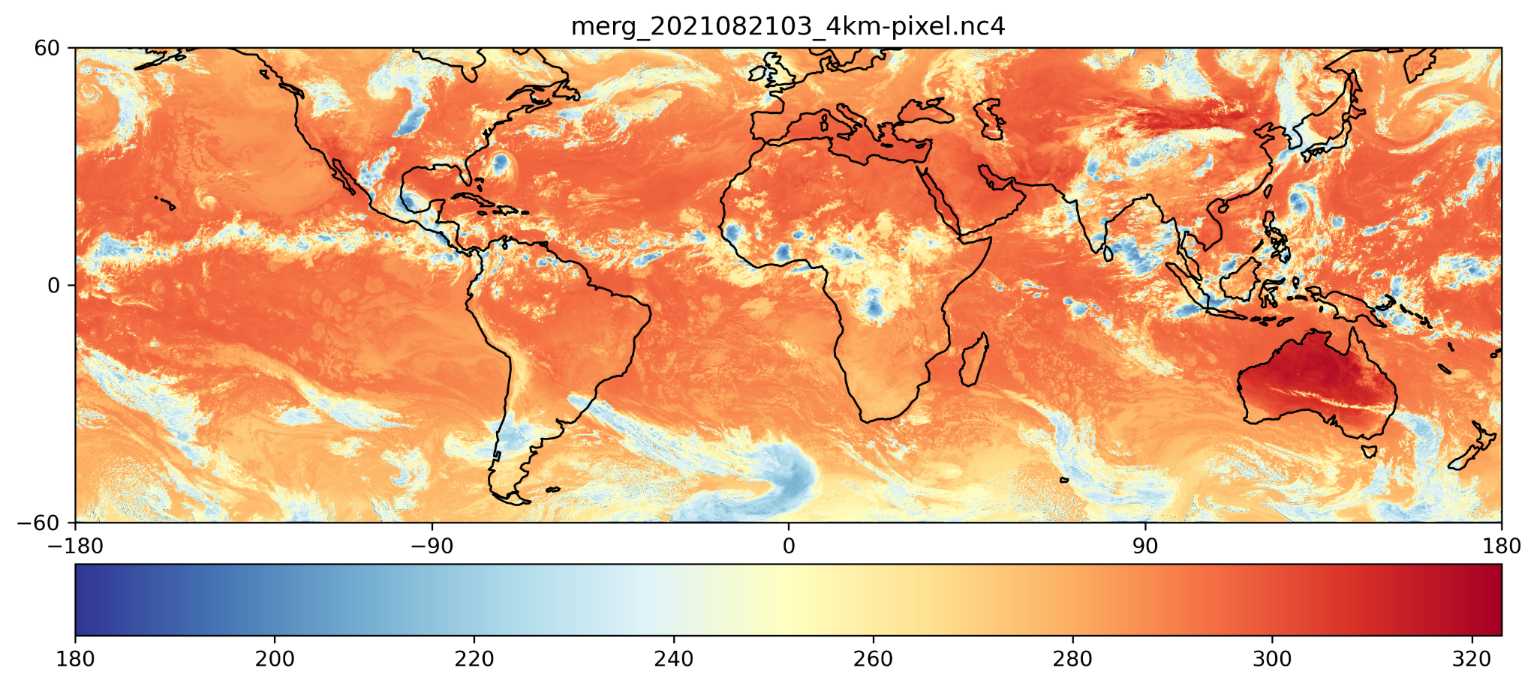
Snapshots

Slide 6
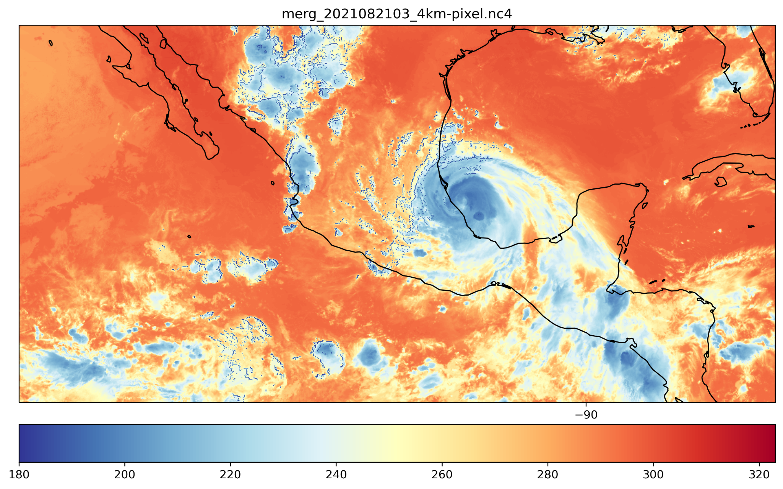
Snapshots

